Slide 1
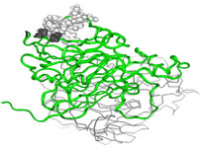
Group 3s - Data analysis of the Dorothea dataset.
For UFMFGQ-15-M Data analytics for engineers.

Slide 2
Dorothea dataset and Big Data. Introduction.
The Dorothea dataset was designed and used initially for the 2003 NIPS feature selection challenge.
The data is provided by DuPont Pharmaceuticals, which we acknowledge when using this dataset.
It represents the spectrometer results of organic molecules, binding or non-binding to receptors of a targeted molecule, to create new compounds for drug discovery.

Slide 3
Dorothea dataset and Big Data. Challenge
Size of the dataset means its impossible for humans to spot trends.
Working with full datasets results in hours of code compiling time on modern computers if reduction techniques are not used.
Creation, compiling and storage of original dataset would have had considerable cost implications.

Slide 4
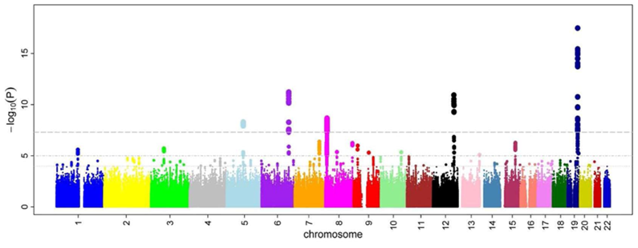
Dorothea dataset and Big Data Challenge: Modern examples
Modern drug development is often undertaken using human genome sequencing.

Slide 5
Dorothea dataset and Big Data. Challenge: Modern examples
New techniques can look at biological links, rather than single receptors of molecules as with the Dorothea dataset.
Costs of initial drug research is huge. An article published in 2015 by pharmaceutical-journal.com estimates this at £1.15 Billion. Initial research is typically 1/3rd of the cost.

Slide 6
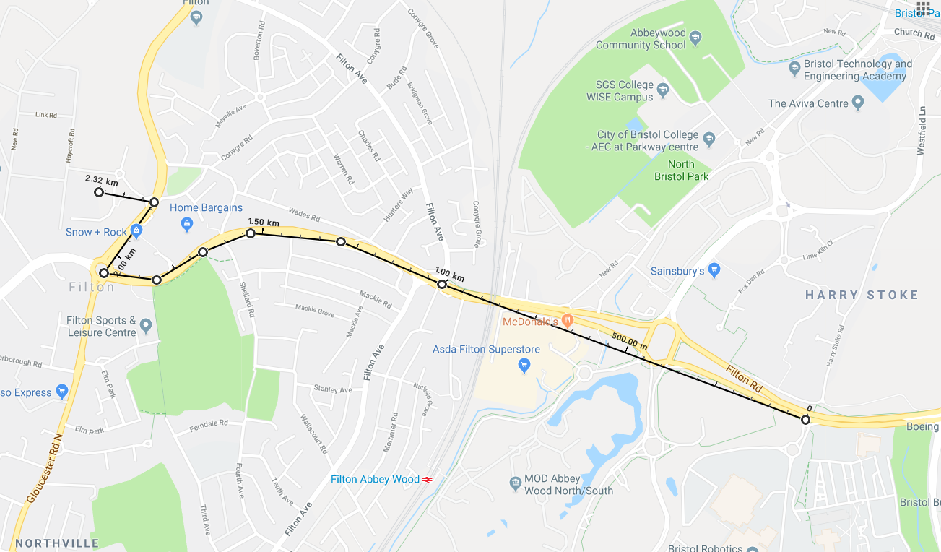
Data Cleaning & Exploration
Full Dataset
Smaller version
No Zero columns
Notes:
Extremely large dataset. 800rows by 100,000 columns
If you printed that out it would be 5m x 2.3km! = 180,000 sheets of A4 = 360 reams. Unwind it from the west gate to barnwell!
Drop the columns which are all zeros – takes it down to 88,000
This still leaves an enourmous amount of data – so most of our analysis uses the smaller version for the purposes of speed.

Slide 7
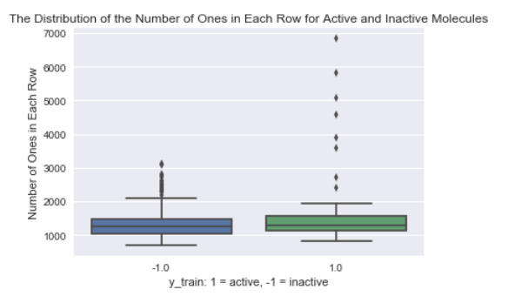
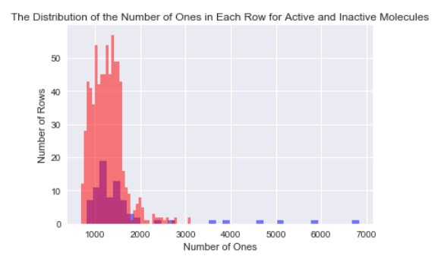
Data Cleaning & Exploration
Notes:
Initial attempt to find some kind of pattern – how many ones are there in a typical row for active and inactive molecules?
Explain graphs
Big difference? - could be used to slightly pare down the dataset – anything above 3000 is probably active

Slide 8
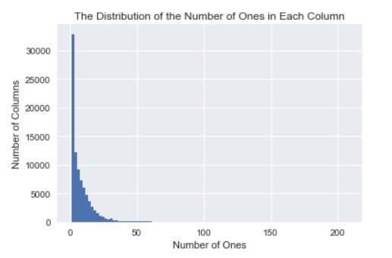
Data Cleaning & Exploration
“….we added a number of distractor feature called 'probes' having no predictive power.”
Number of variables/features/attributes: Real: 50,000 Probes: 50,000 Total: 100,000
Notes:
So half of all the columns are useless!
Quick attempt to find these columns – if they’re randomly assigned 1s and 0s you’d expect a 50, 50 split (400 ones, 400 zeros) which would stick out like a sore thumb.
Alas no – they appear to have been more clever about it than that!

Slide 9
Principle Components Analysis (PCA)
Reforms the data matrix to determine how to keep the maximum amount of data, (variance) in the fewest components, Using the eigenvector, equates an eigenvalue, or the variance retained in a given Axis.
The axis with the highest variance is the first principle component.
By choosing multiple components we amass these variance combinations.
PCA then rebuilds a smaller dataset that reflects the original.

Slide 10
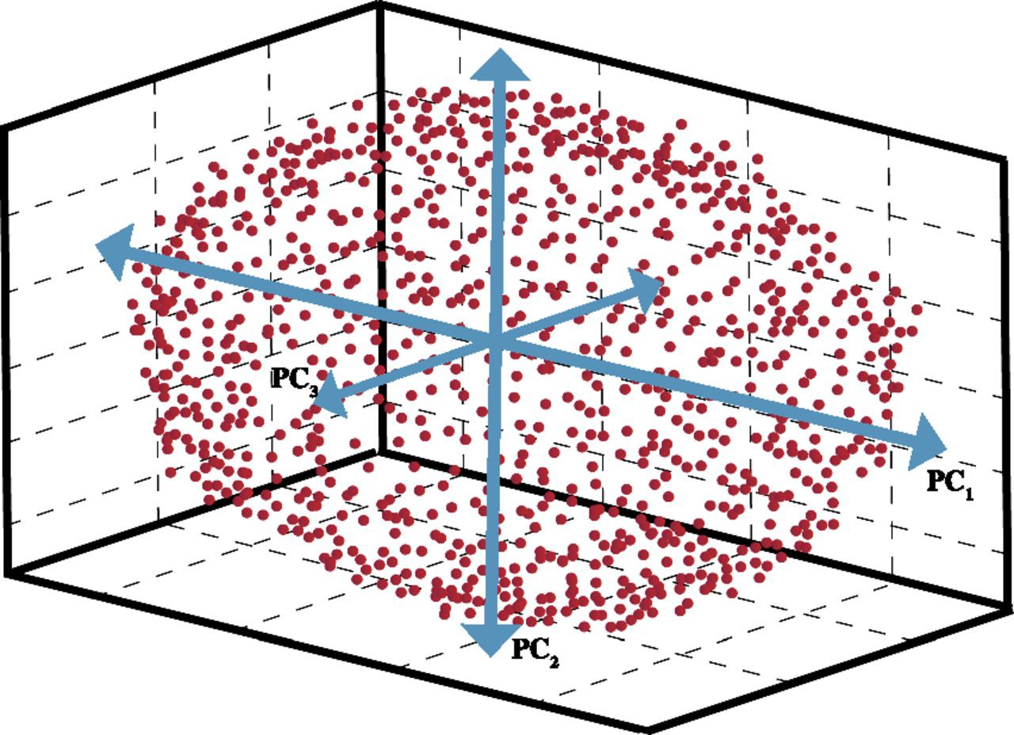
PCA

Slide 11
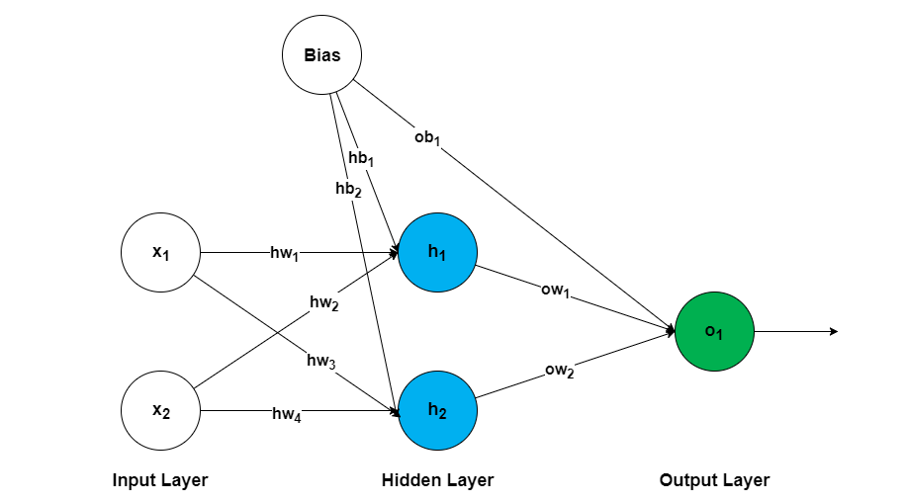
Machine Learning
Method used: Artificial Neural Network
Learning Rate: 0.0001
Hidden Nodes: 8
Epochs: 5000

Slide 12
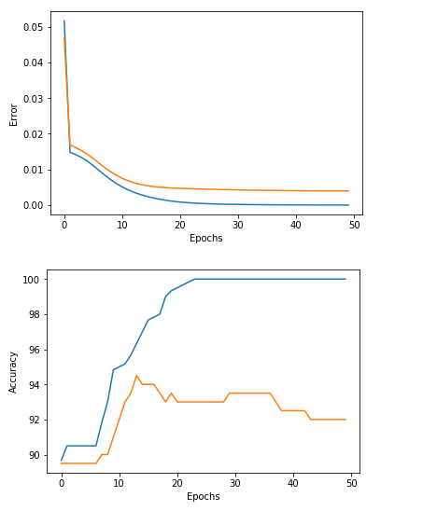
Machine Learning - results

Slide 13
Logistic regression
Particularly suitable for Binary (Dichotomous) data, as only works on integer values.
It’s a supervised classification algorithm, we have an assigned class indicator.
Classifies data into a class, but also predicts what class that should be, and assigns a probability.
Predictions gained on training data, can be applied to test data to validate learning.

Slide 14
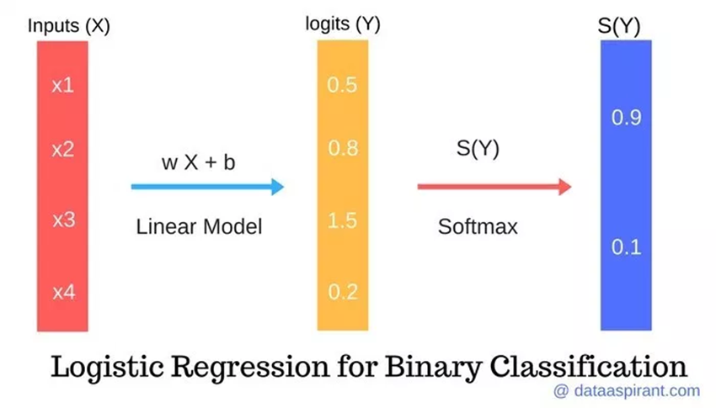
Logistic regression
Using linear regression, then producing a Logit, and the softmax function (Blackbox) we get a class prediction.

